Slide 1
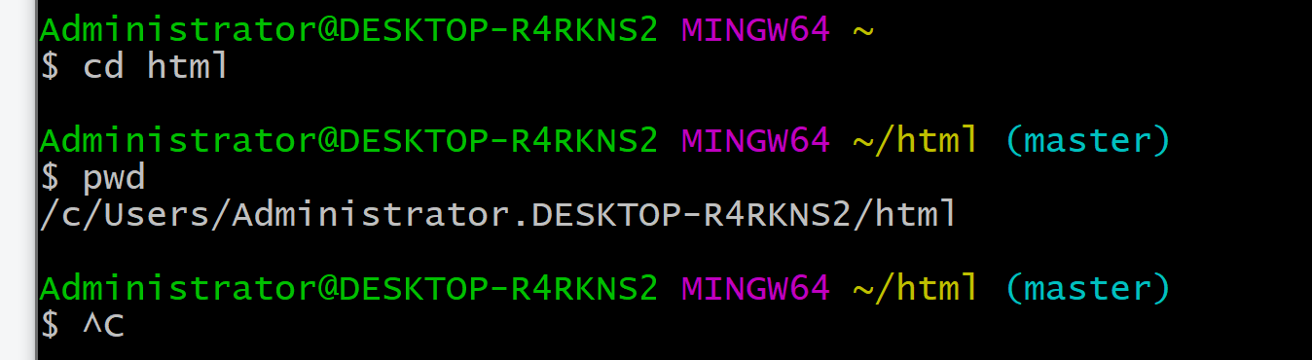
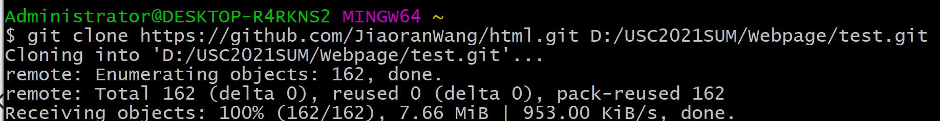
Notes:
[git clone repo/diction] https://blog.csdn.net/techbirds_bao/article/details/9179853

Slide 2
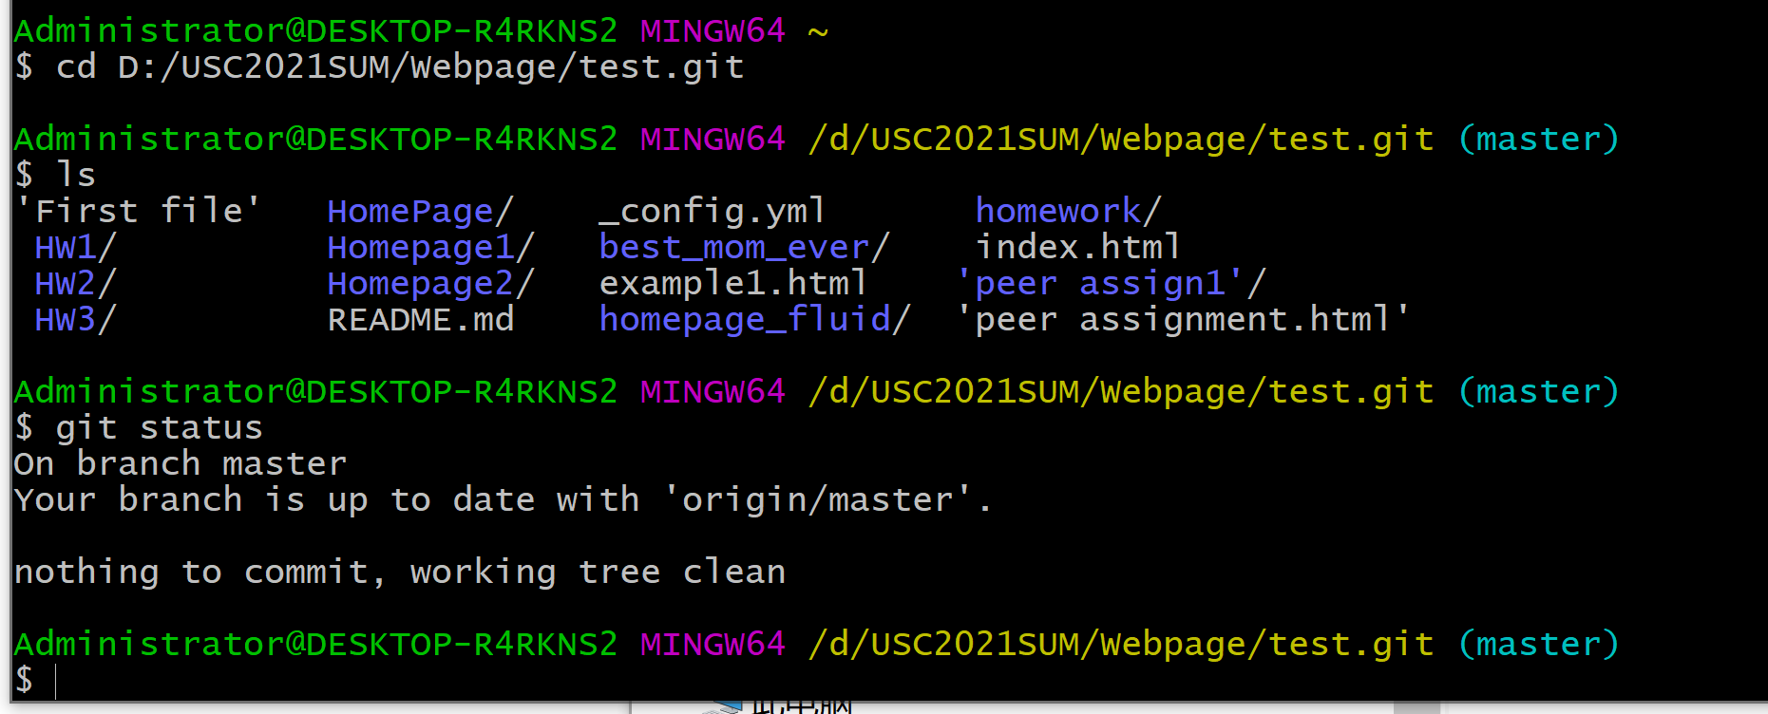
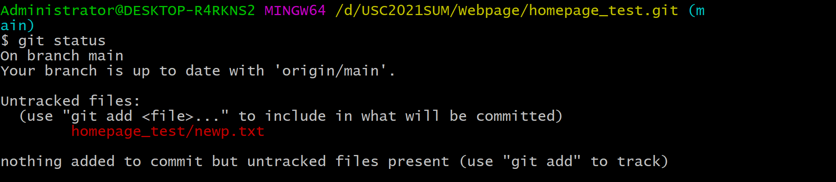
Notes:
https://www.datacamp.com/community/tutorials/git-push-pull

Slide 3
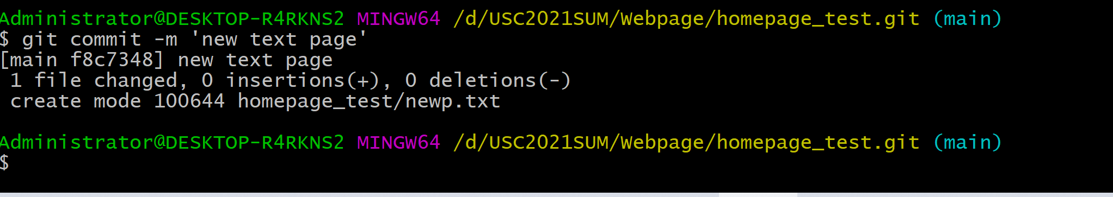
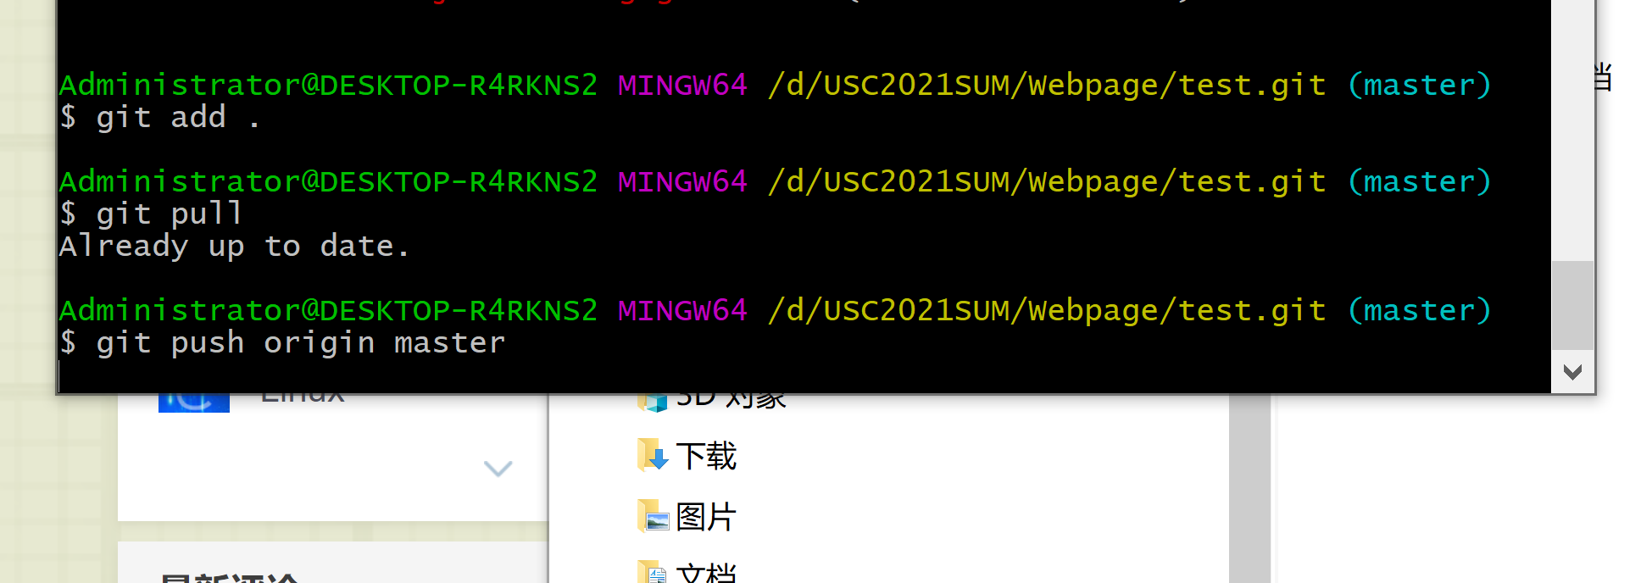

Slide 4
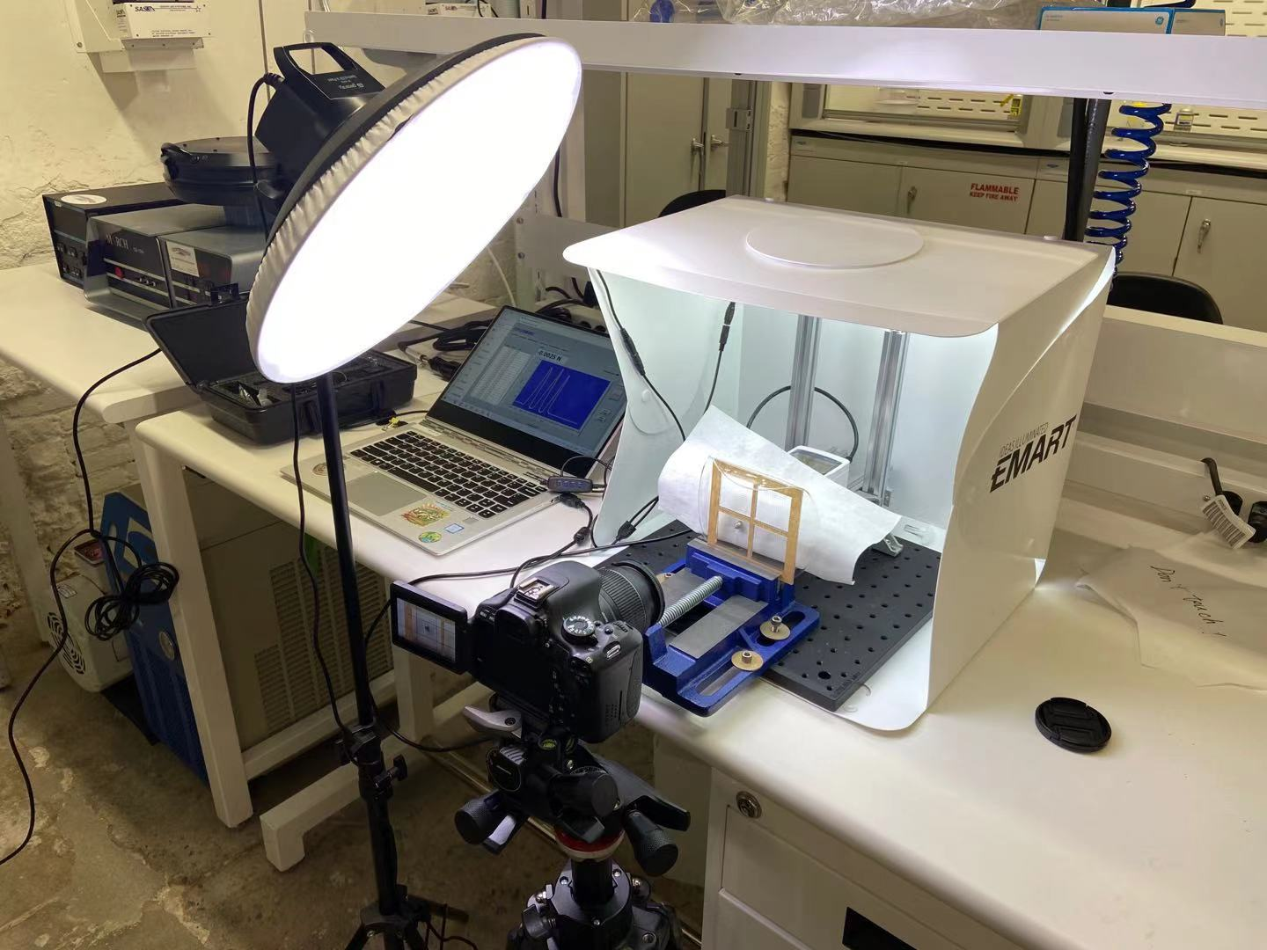
Project in Progress…
Notes:
[adding translate button] https://www.conveythis.com/zh/how-do-i-add-the-translate-button-to-my-website/
[adding language] https://www.youtube.com/watch?v=CU79qSFqJ6w

Slide 5
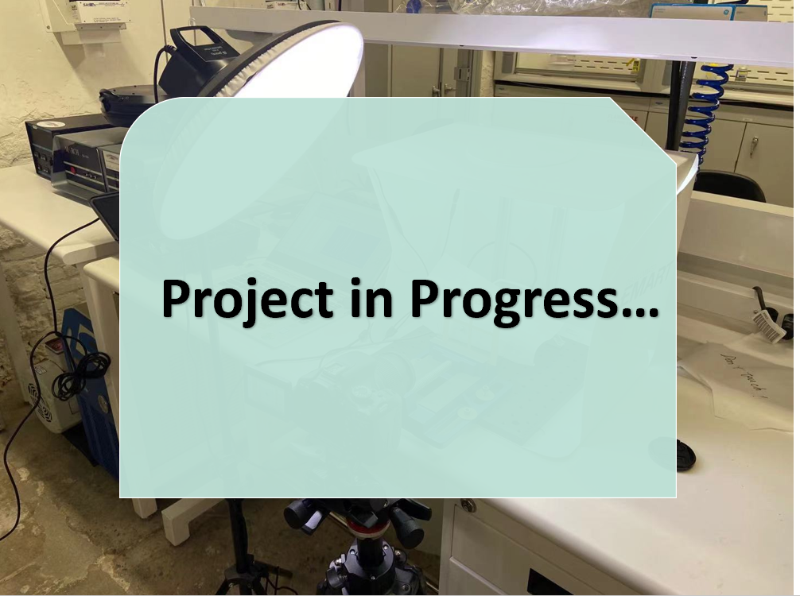

Slide 6
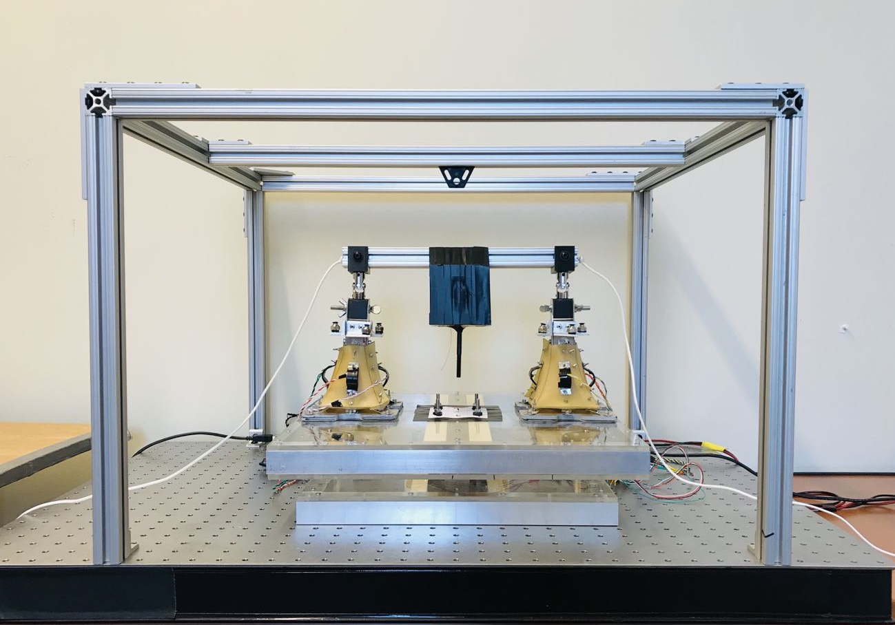
Project Unreleased

Slide 7
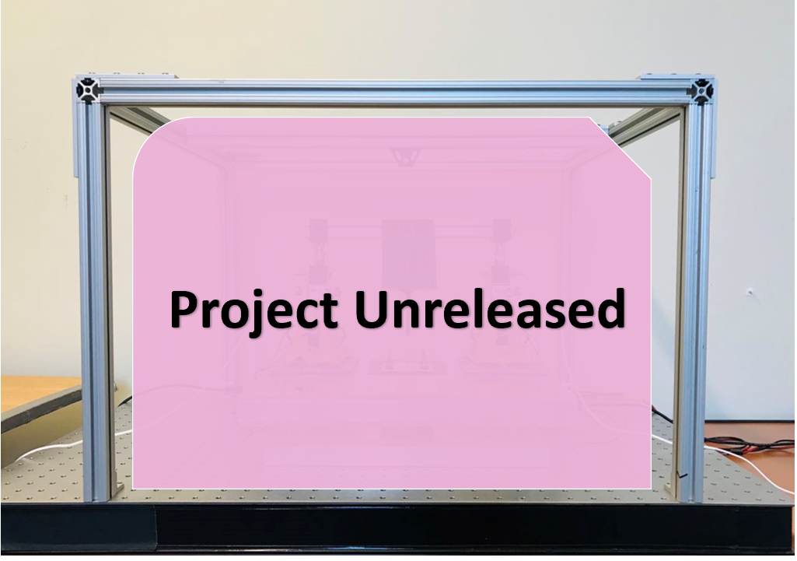

Slide 8
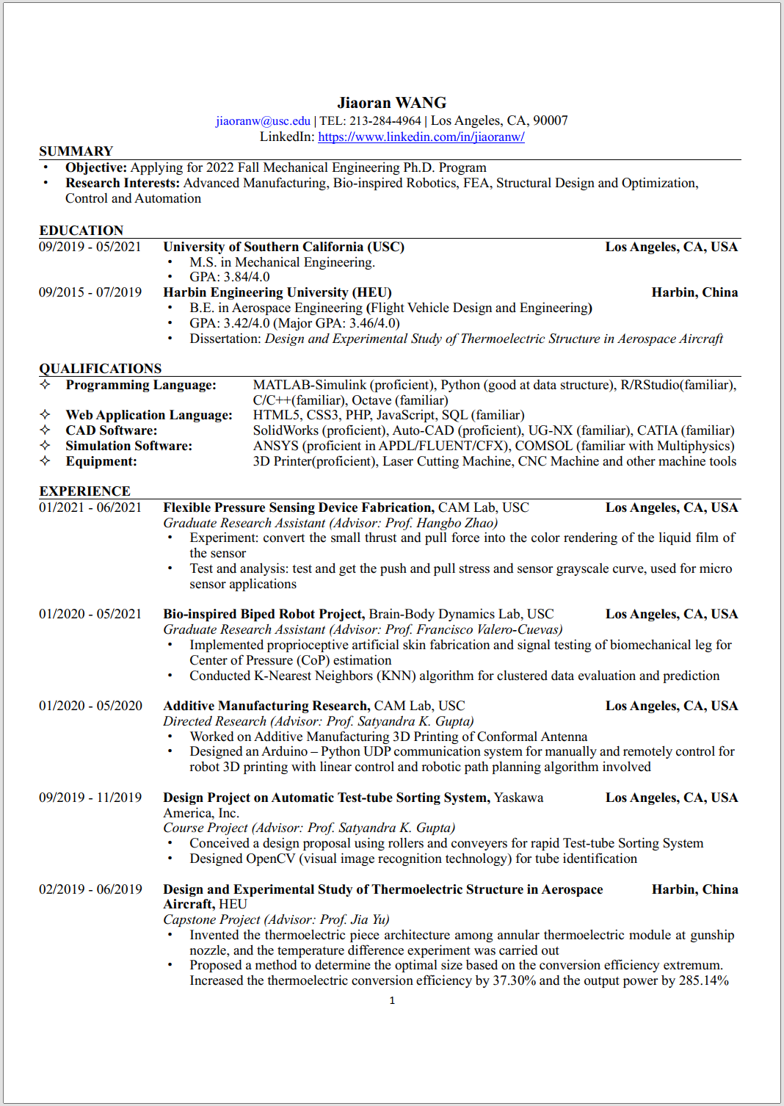
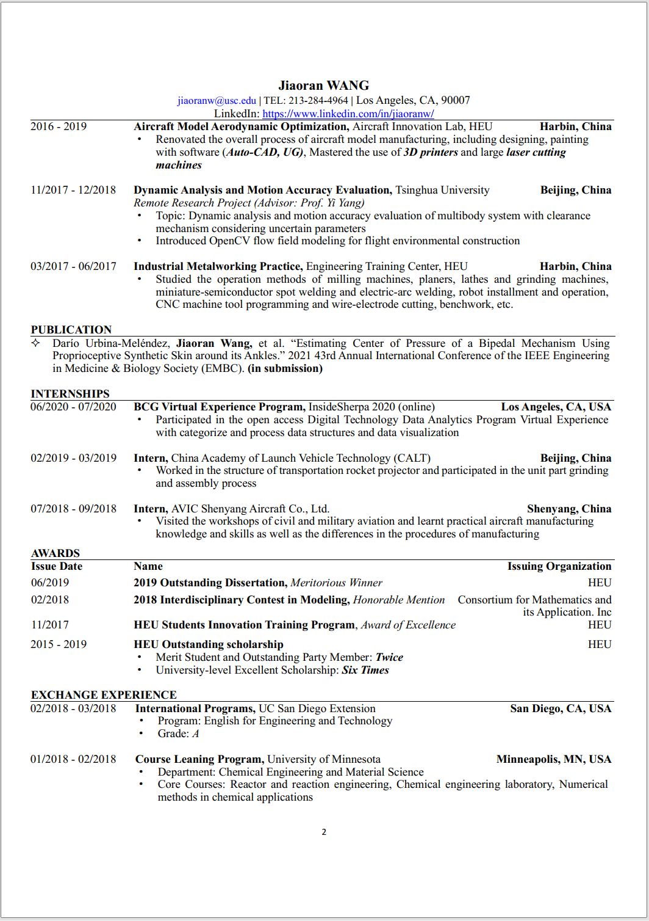
Notes:
[如何居中图片] html的图片怎么居中-html教程-PHP中文网 棒棒！！
[] html怎么让表格在页面居中-百度经验 (baidu.com)
[网页留言] 为网页添加留言功能_weixin_33854644的博客-CSDN博客
https://www.uisdc.com/how-the-page-opens-interactively
https://blog.csdn.net/u012526003/article/details/52167433
[全部ppt保存成长图] https://jingyan.baidu.com/article/219f4bf7b43523de452d3866.html
[批量插入图片] https://jingyan.baidu.com/article/fea4511a049456f7bb91259e.html

Slide 9
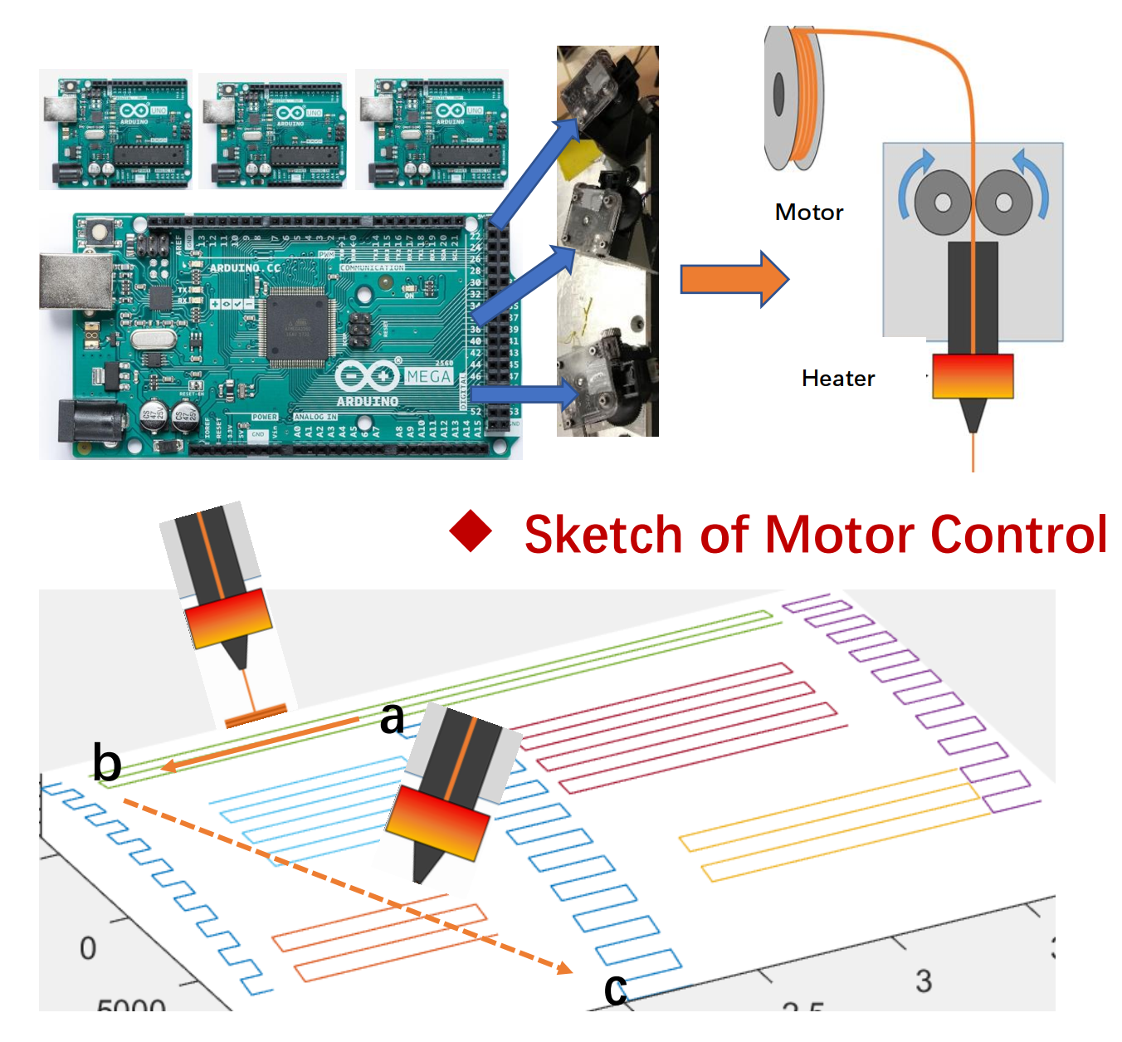

Slide 10
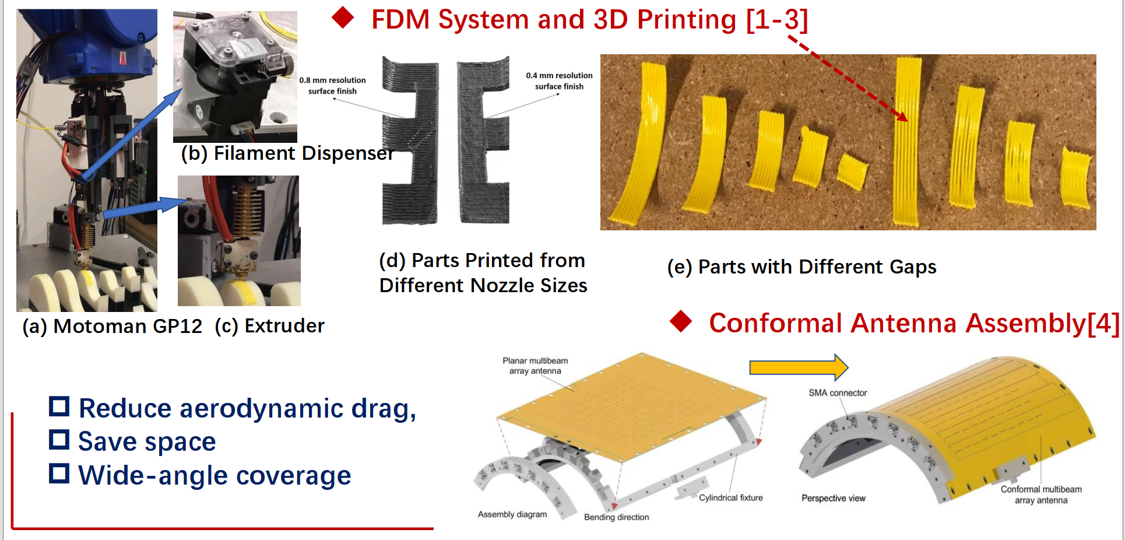

Slide 11
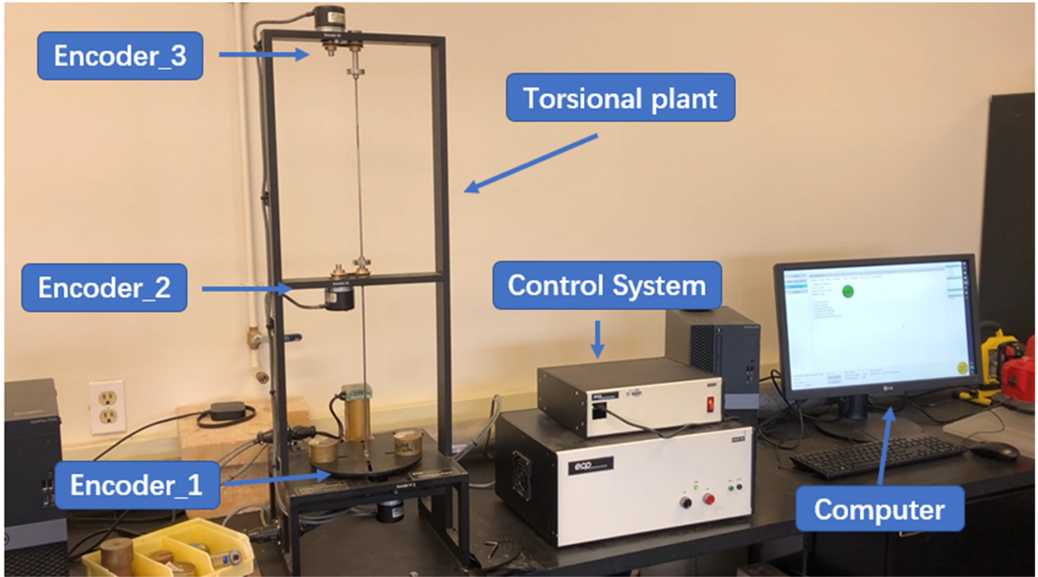

Slide 12
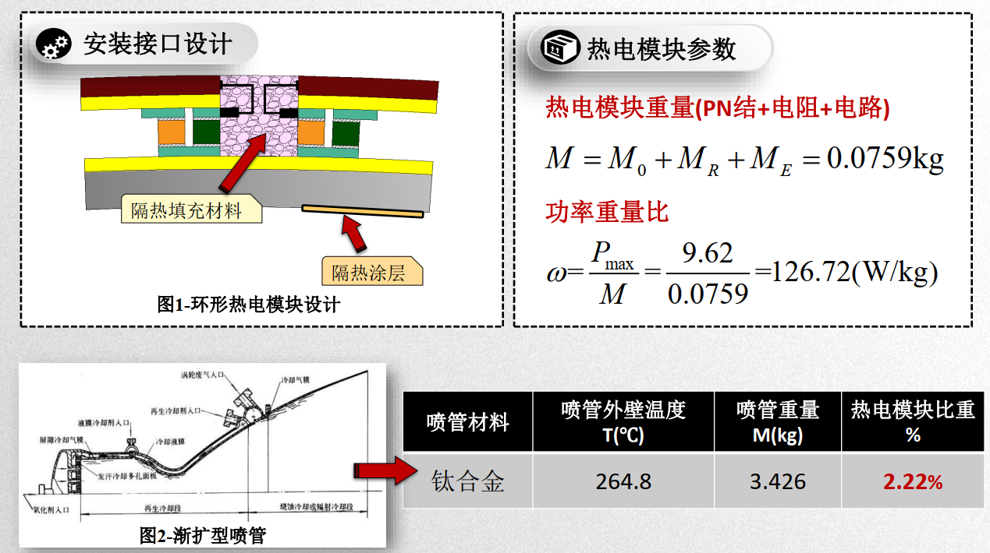

Slide 13
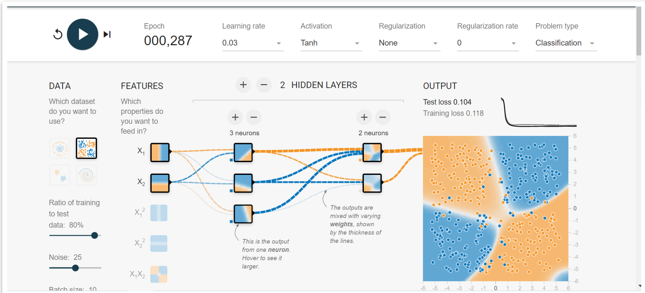

Slide 14
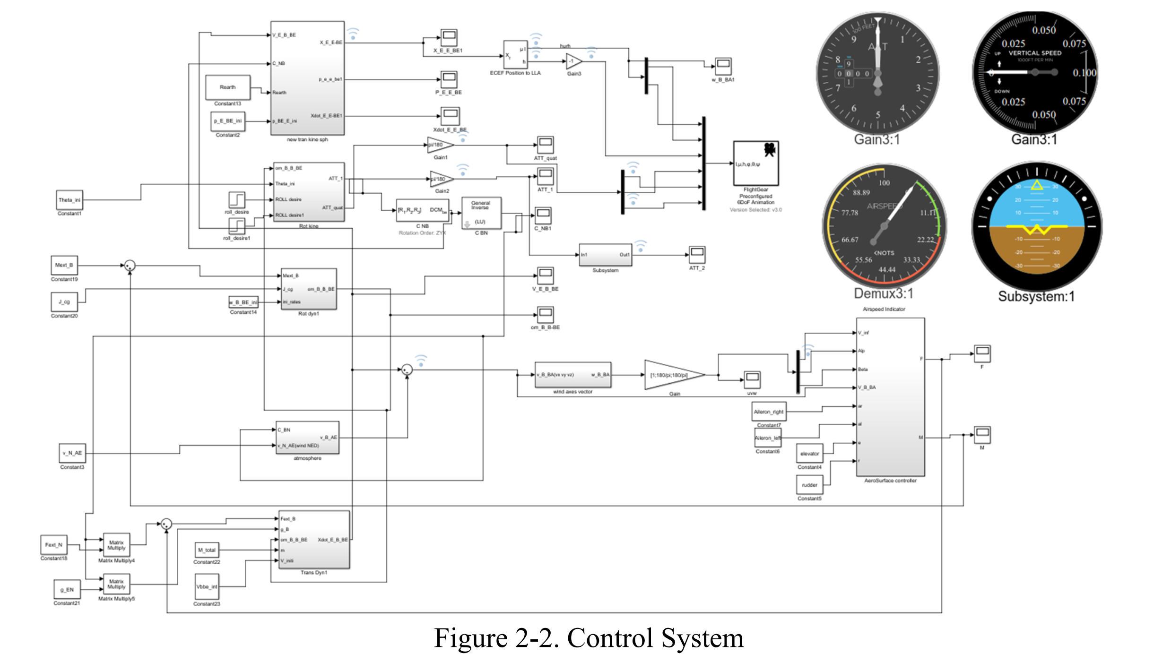

Slide 15
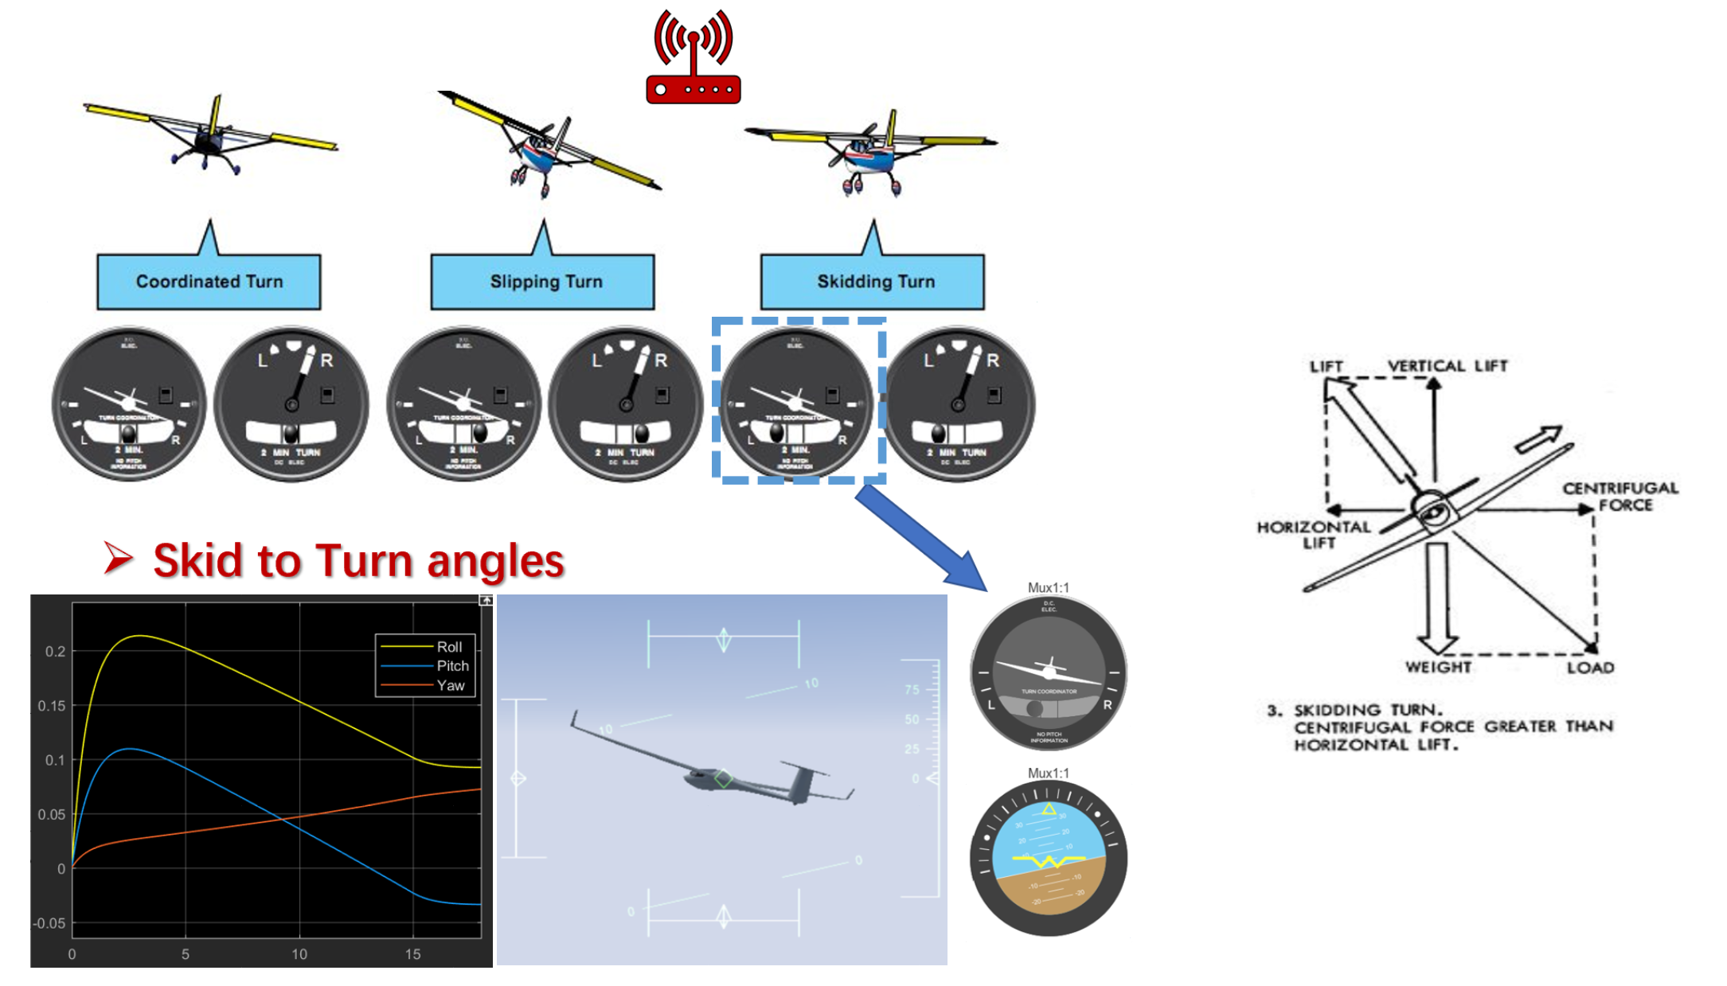

Slide 16


